Slide 1
NOUGHTS AND CROSSES
INTRODUCTION TO ARTIFICIAL INTELLIGENCE
BY:
YASHPREET MALHOTRA
TULIKA KOTIAN
Notes:
© Copyright PresentationGO.com – The free PowerPoint and Google Slides template library

Slide 2

NOUGHTS AND CROSSES
12/06/21
Notes:
© Copyright PresentationGO.com – The free PowerPoint and Google Slides template library

Slide 3
NOUGHTS AND CROSSES GAME
Definition: A game in which two players alternately put Xs and Os in grid of a figure formed by two vertical lines crossing two horizontal lines and each tries to get a row of three X’s or three O’s before the opponent does

Slide 4
OBJECTIVES
12/06/21
Notes:
© Copyright PresentationGO.com – The free PowerPoint and Google Slides template library

Slide 5
OBJECTIVES
Design Minimax, Expectimax and Q-Learning Algorithm agents to solve the Tic-Tac-Toe game.
Play the Tic-Tac-Toe with the designed model.
Tic-Tac-Toe game logic depends on:
Each puzzle consists of a grid containing X's and O's in various places. The object is to place X or O in remaining squares so:
1. There are no more than three consecutive X's or O's in a row or a column in the entire grid.
2. All rows and all columns have unique combinations of X’s and O’s.
Notes:
© Copyright PresentationGO.com – The free PowerPoint and Google Slides template library

Slide 6
APPROACH
12/06/21
Notes:
© Copyright PresentationGO.com – The free PowerPoint and Google Slides template library

Slide 7
APPROACH
Layout
Training the agent about the Tic-tac-toe environment.
Define the agent which minimizes our utility.
Develop a counter strategy for ourself to maximise our utility
We are using expectimax to decrease the limitations of minimax and further expand our utility.
Then we add a choice node to study actions of the agent and use Q learning to get the max utility.
Notes:
© Copyright PresentationGO.com – The free PowerPoint and Google Slides template library

Slide 8
DELIVERABLES
12/06/21
Notes:
© Copyright PresentationGO.com – The free PowerPoint and Google Slides template library

Slide 9
DELIVERABLES
User documentation manual which gives details about the Tic – Tac – Toe game implementation using Minimax, Expectimax and Q-Learning.
Algorithms developed for Learning agent using python programming language(.py files)
GitHub repository link for project code and related files.
YouTube video demonstrating project implementation and slides.

Slide 10
GAME LAYOUT
12/06/21
Notes:
© Copyright PresentationGO.com – The free PowerPoint and Google Slides template library

Slide 11
GAME LAYOUT
Two signs represent each player.
The general signs used in the game are X and O.
The game is designed to be a 3x3 grid, i.e. a grid with 9 boxes.
The centre box (Position: 2nd row, 2nd column) is the default starting point of the game by the agent.
The game is played between a human and a computer(our program), and the result is displayed as: (1) You win! (2) Computer wins! (3) Tie!

Slide 12
RESULTS
12/06/21
Notes:
© Copyright PresentationGO.com – The free PowerPoint and Google Slides template library

Slide 13
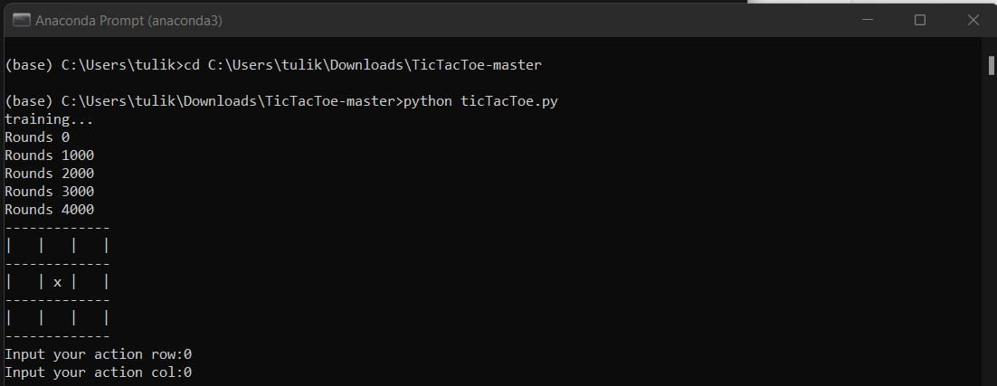
RESULTS

Slide 14
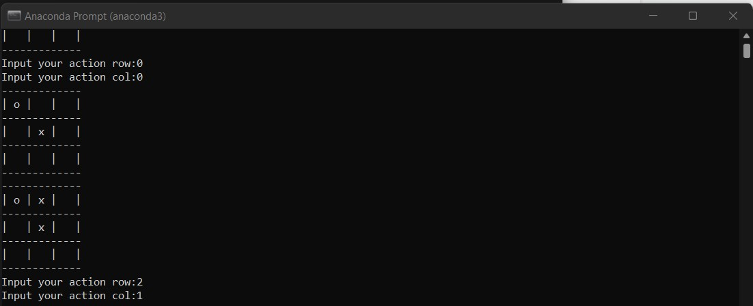
RESULTS

Slide 15
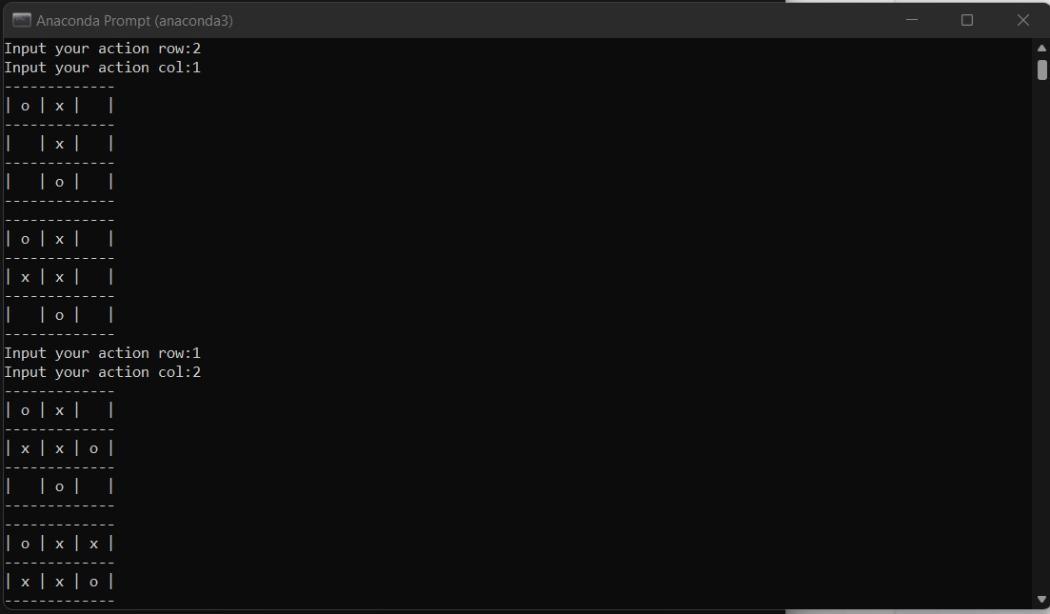
RESULTS

Slide 16
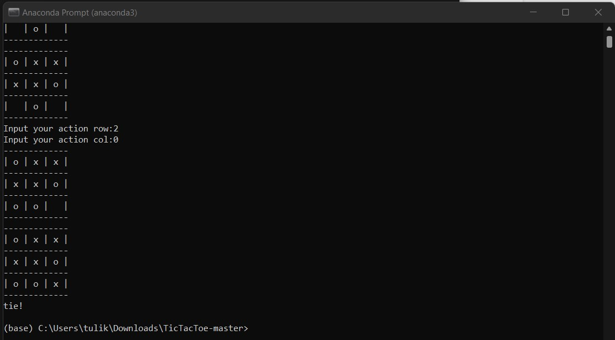
RESULTS

Slide 17
METRICS
12/06/21
Notes:
© Copyright PresentationGO.com – The free PowerPoint and Google Slides template library

Slide 18
METRICS
Correctness
Accuracy
Agent’s Response

Slide 19
ANALYSIS
12/06/21
Notes:
© Copyright PresentationGO.com – The free PowerPoint and Google Slides template library

Slide 20
ANALYSIS
Correctness: Every time we run the game on different inputs each time we get the correct output satisfying all constraints.
Accuracy: Every time we are getting correct tic-tac-toe formation for different types of inputs, hence the constraints are satisfied accurately

Slide 21
Thank You!
Notes:
© Copyright PresentationGO.com – The free PowerPoint and Google Slides template library

